Slide 1
Introduction to consumer and financial literacy education in Australia
Helping young people be MoneySmart
Notes:
Slide 1

Slide 2
Consumer and financial literacy is taught as a context for learning across the existing Australian Curriculum

Slide 3
MoneySmart Teaching Strategy
DRIVERS
OECD
NFL Strategy
NCFL Framework
Australian Curriculum
Australian Professional Standards for Teachers
MoneySmart Teaching website
Digital resources
Teacher guide
Confident and informed investors and financial consumers
Target audiences: Teachers
Students Parents
Videos
Facilitator guide
MoneySmart Teaching Packages
Units of work
Online Professional Learning
Enterprise case study
VET Certificates III and IV in Financial Services
Goal
Beginning

Slide 4
Who are consumer and financially literate people?
Individuals who have the ability to apply knowledge, understandings, skills and values in consumer and financial contexts to make informed and effective decisions that have a positive impact on themselves, their families, the broader community and the environment.
Source: National Consumer and Financial Literacy Framework, Education Council 2011, http://scseec.edu.au/archive/Publications.aspx

Slide 5
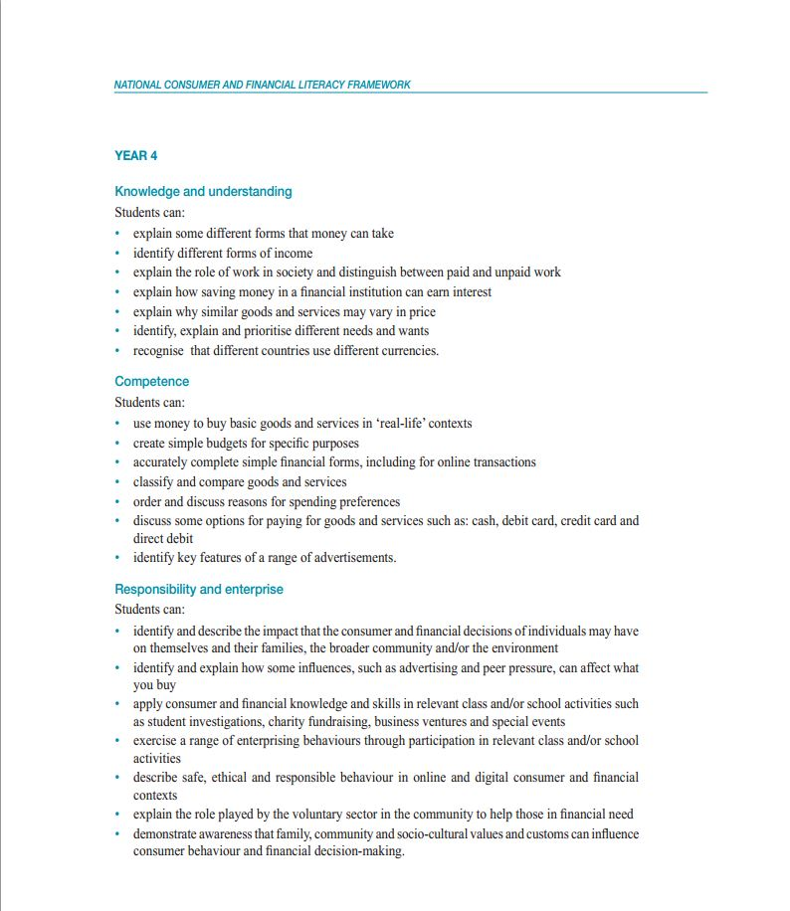
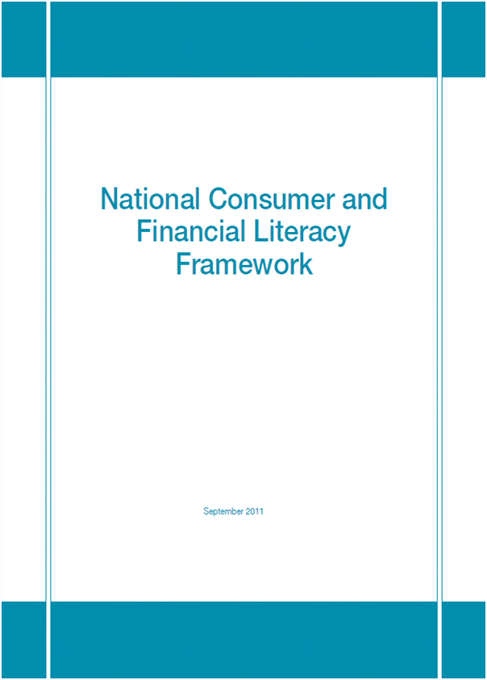
National Consumer and Financial Literacy Framework
Knowledge and understanding money and consumer decisions
Competence applying knowledge
Responsibility and enterprise making choices
Notes:
The Framework uses three interrelated dimensions of learning. Each of these dimensions has a number of student learnings.
Student learning is described in 2 year bands for each dimension and represents what students should know, understand and be able to demonstrate at the end of each band.
Knowledge and understanding: is about the nature and forms of money, how it is used, consequences of consumer decisions (click on magnifying glass to show student learnings)
Competence: is about the application of consumer and financial knowledge and skills in range of contexts
Responsibility and enterprise: is about making appropriate consumer and financial decisions, while providing opportunity to use initiative and manage risk-taking.
All of the MST resources clearly identify the dimensions and student learnings and we will see how this is done later on in a unit of work.
Background info for presenter
There is a copy of the Framework in the Appendices of the Teacher Guide.

Slide 6
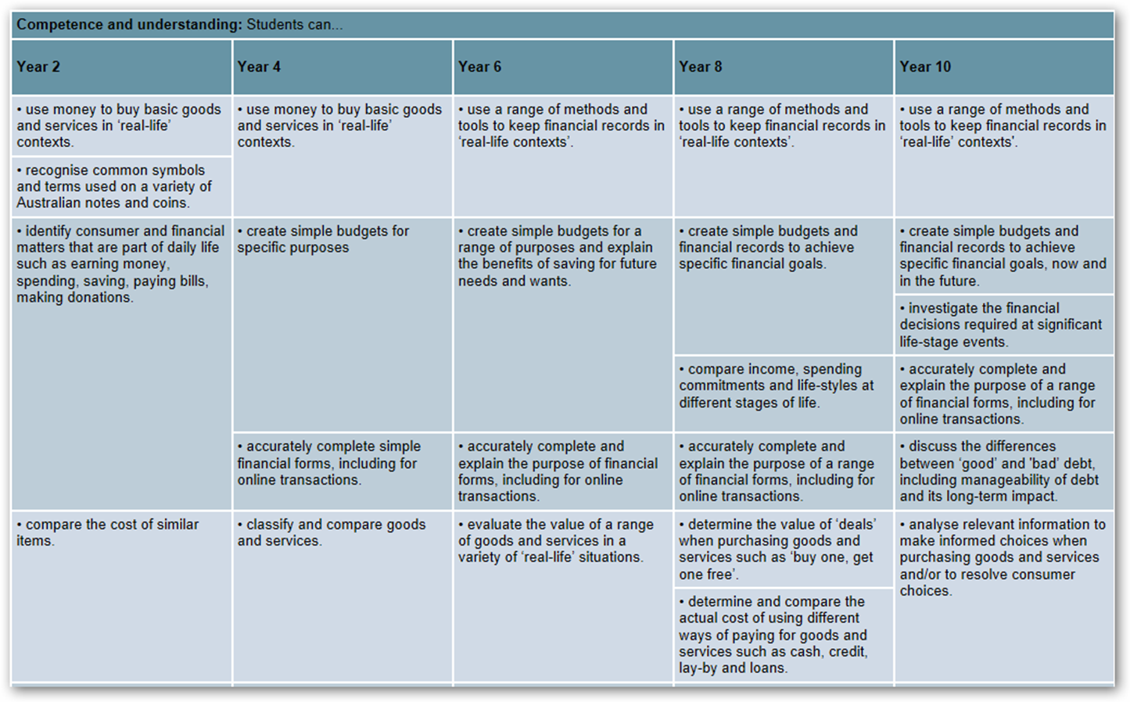
Progression of learning

Slide 7
What are the benefits?
Students:
Teachers:
Develop consumer and financial literacy capabilities
Demonstrate responsible consumer and financial literacy behaviours characterised by informed decision making.
Real financial contexts for learning
Building capability: confidence, knowledge, resources
Wellbeing: personal learning, reflective practice, financial health
Leadership: professional learning, school journey, development of a learning culture in the school
7

Slide 8
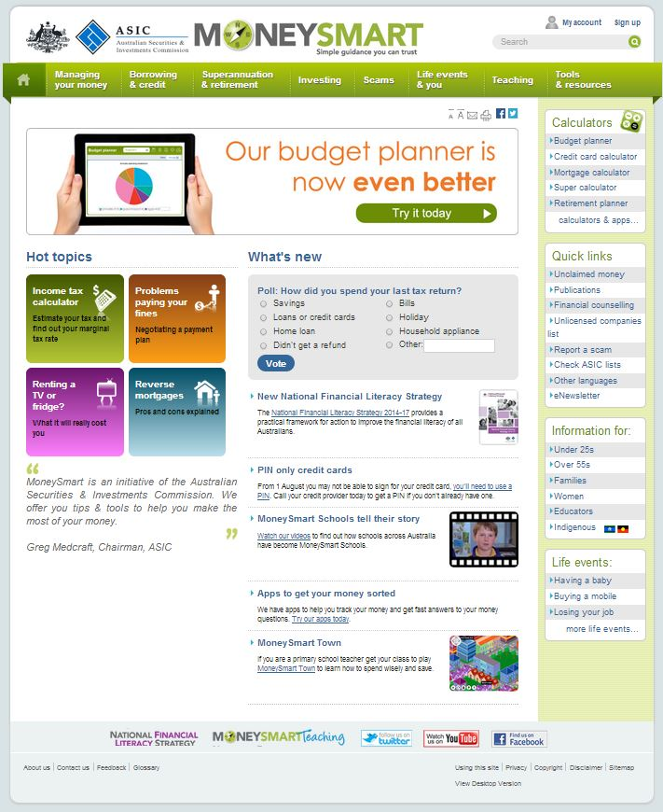
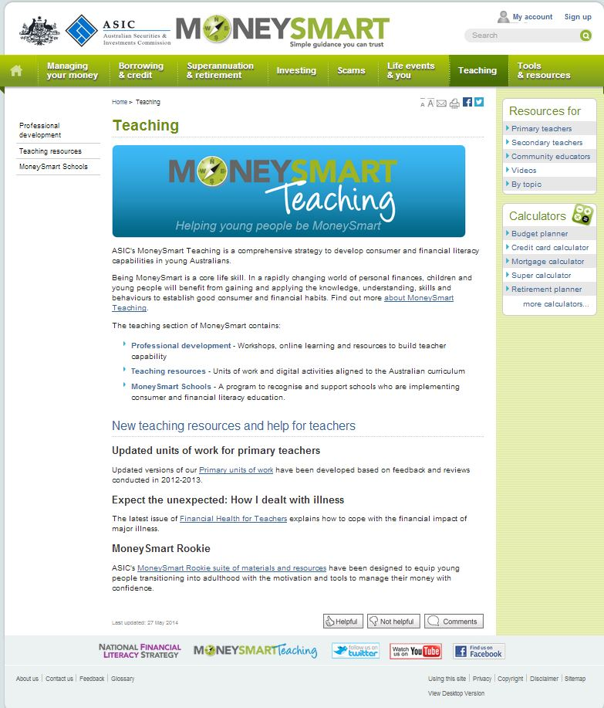
MoneySmart brand
https://www.moneysmart.gov.au
https://www.moneysmart.gov.au/teaching

Slide 9
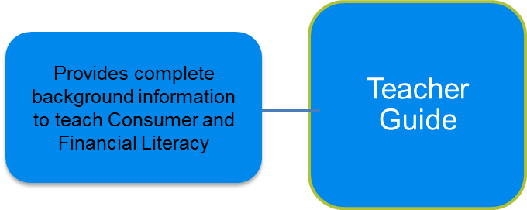
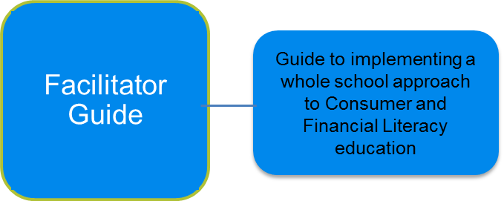
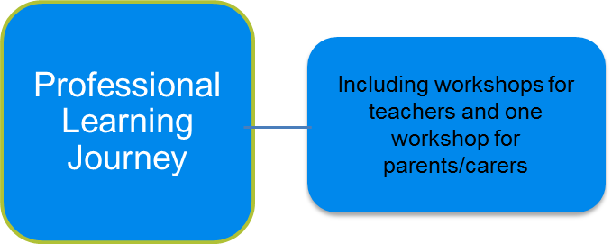
MoneySmart Teaching Professional Learning Packages
https://www.moneysmart.gov.au/teaching/teaching-resources

Slide 10
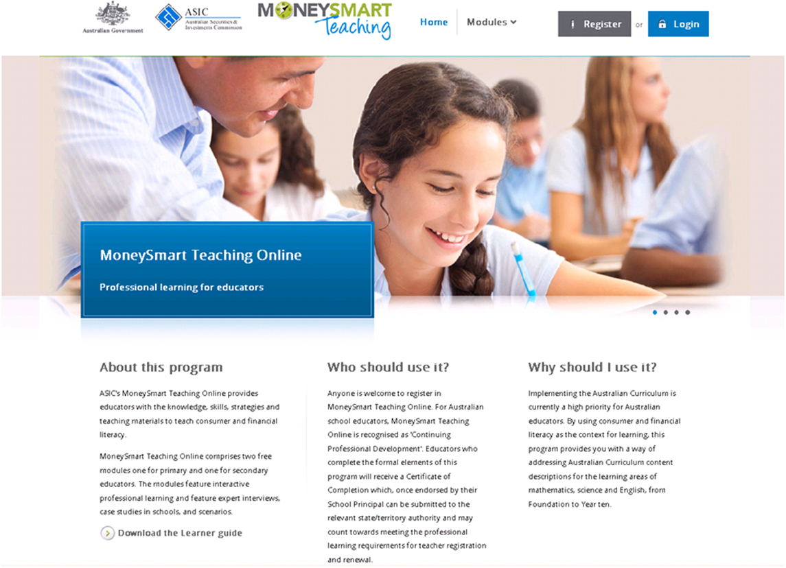
Professional Learning Online

Slide 11
MoneySmart Teaching Units of Work
Integrated Foundation to Year 6, Mathematics Years 1-10, Science 7- 8, English 9-10
dff
Have Australian Curriculum content descriptions
Link to the National Consumer and Financial Literacy Framework
Notes:
Slide 11

Slide 12
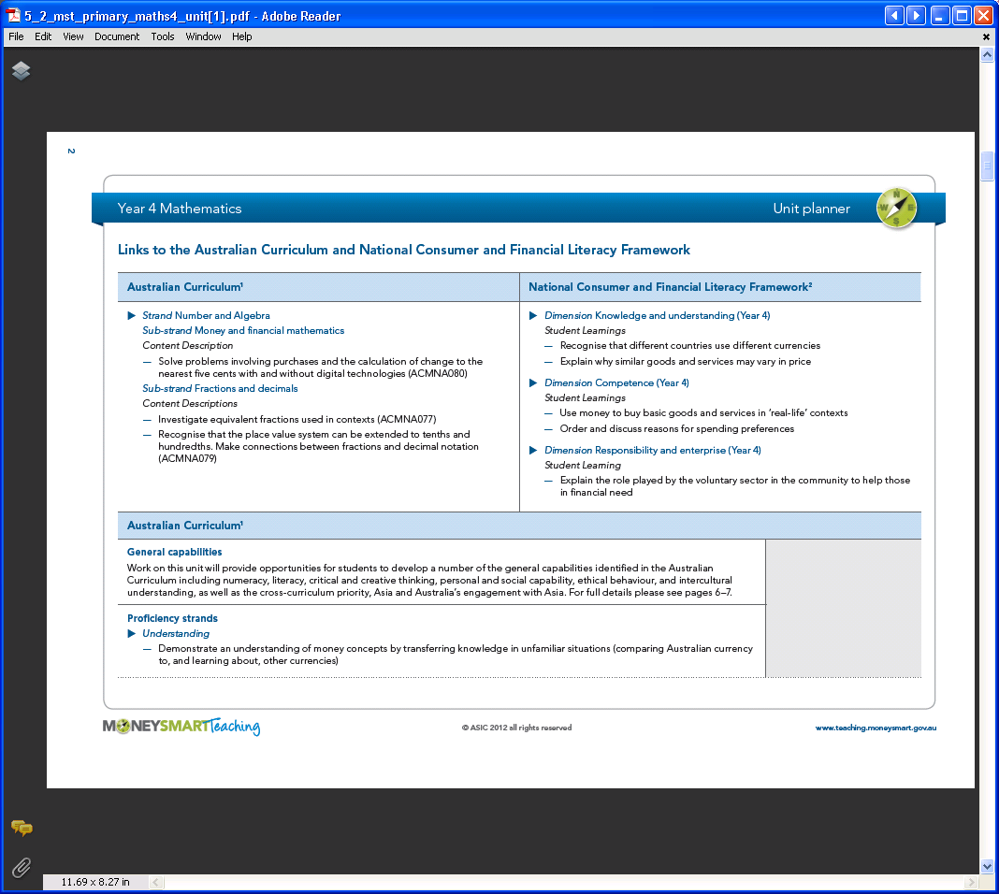
Mapping to the Curriculum and Framework
Links to NSW syllabus

Slide 13
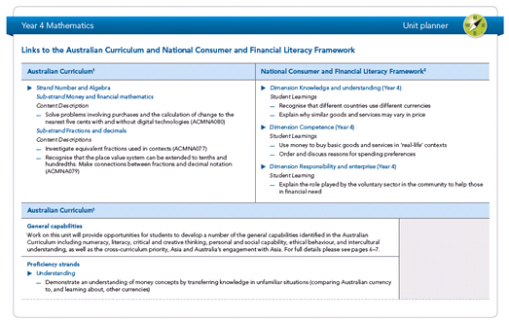
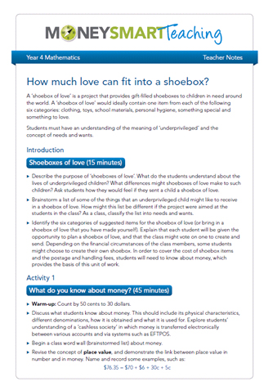
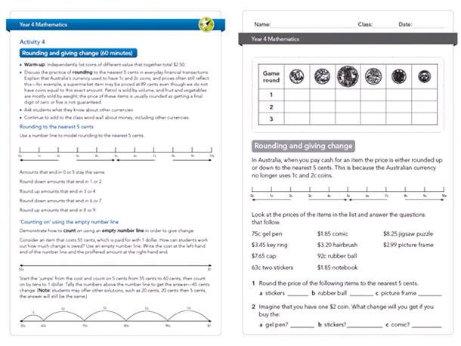
MoneySmart Teaching: Units of work
Unit planner – overview of unit
Teacher notes
Student materials
Notes:
Slide 13

Slide 14
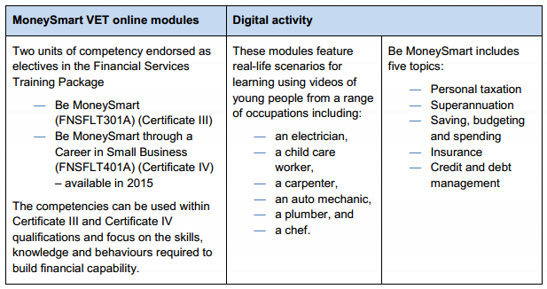
Certificate III Be MoneySmart

Slide 15
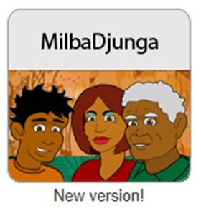
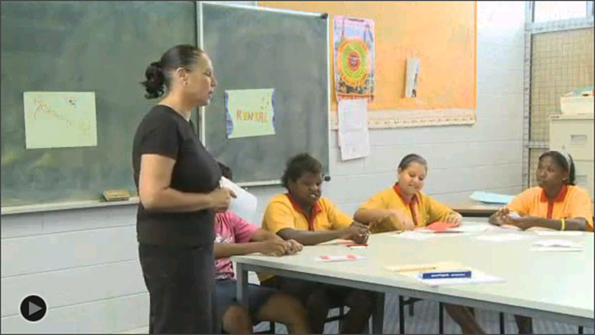
MilbaDjunga
Interactive online primary and secondary units to support teachers of Aboriginal and Torres Strait Islander students to teach consumer and financial literacy.
Year 5 and 6 unit: Do I need it? Do I want it? How can I get it?
Year 9 unit: How can I start my own business?

Slide 16
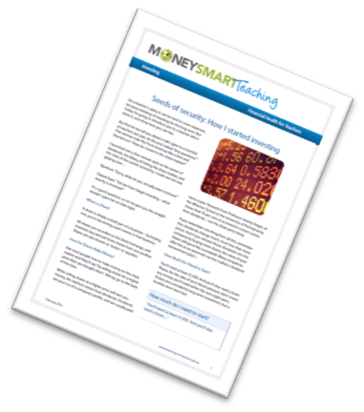
Financial Health for Teachers
A MoneySmart Teaching personal learning program
Designed to inspire and empower teachers
Aims to help teachers feel confident with money
Published regularly on the MoneySmart Teaching website
Subject line: ‘Subscribe’ to moneysmartteaching@asic.gov.au

Slide 17
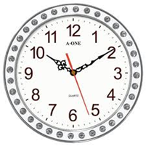
Financial Health for Teachers
Topics include:
Breaking the debt cycle
Being debt free
Retire ready – How I set myself up
Surviving divorce
Family finances
How I bought my first house
A challenge is presented in each topic - what can I do in:
60 minutes...
6 hours...
6 days...
to improve financial wellbeing?

Slide 18
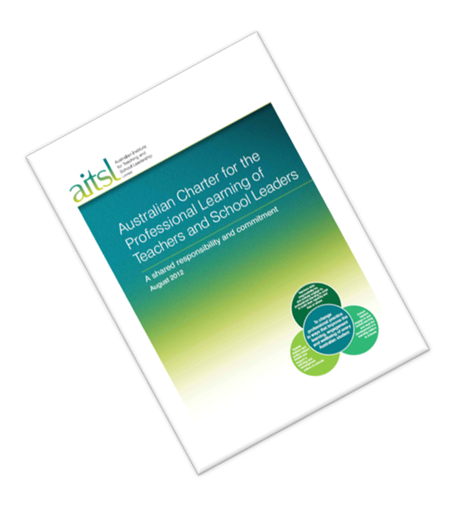
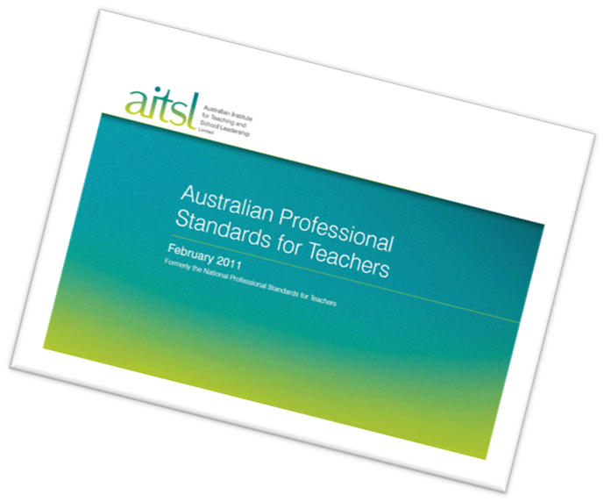
Leadership
MST professional learning
Connects AITSL’s Australian Charter for the Professional Learning of Teachers and School Leaders with real life application in the classroom
Aligns to the Australian Professional Standards for Teachers
Provides leadership opportunities through a whole school consumer and financial literacy approach.

Slide 19
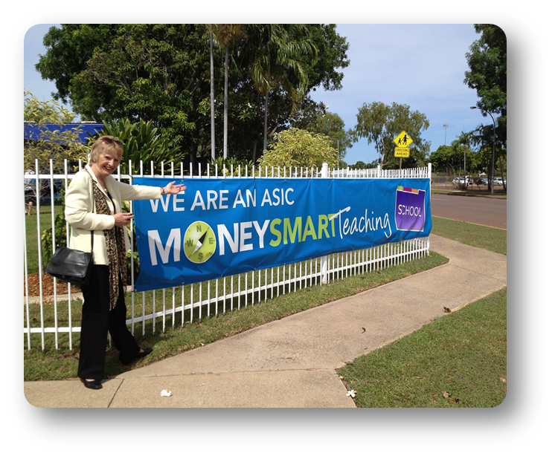
Benefits of being a MoneySmart School
Staff development - staff development and leadership opportunities
Project Officer support - Support from Project Officer in the delivery of training, curriculum implementation and community engagement approaches
Promotional support - public relations and marketing support
Showcase your efforts - showcase your consumer and financial literacy initiatives on website.

Slide 20
Registering as a MoneySmart School
Registration on the MoneySmart Teaching website

Slide 21
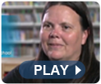
Benefits of MoneySmart Teaching
Experts, principals, teachers and students reflect on the MoneySmart Teaching program and the positive outcomes
Teachers
Primary Students
Secondary Students

Slide 22
MoneySmart Teaching will:
…..create a generation of young people who demonstrate responsible consumer and financial literacy behaviour characterised by informed decision making.

Slide 23
For further information or to book a FREE one hour presentation at your staff meeting –
Contact: Colleen Blancato: NSW DEC Project Officer:
colleen.blancato@det.nsw.edu.au
Phone: 02 9266 8963
All participants at the face to face presentation will receive hard copies of the teaching resources.

