Slide 1
Learning across the curriculum areas: An introduction
Elisabeth Robertson
Curriculum Advisor, Educational Services
Notes:
Learning across the curriculum content assists students to achieve the broad learning outcomes (not the subject-specific outcomes) defined in the Board of Studies K–10 Curriculum Framework and in the Melbourne Declaration on Educational Goals for Young Australians (December 2008).
(Explicitly assess? No – embedded in content.)

Slide 2
Previously…
Cross-curriculum content
ICTs
Work, employment and enterprise
Civics and citizenship
Difference and diversity
Gender
Key competencies
Literacy
Multiculturalism
Numeracy
Notes:
Examples of key competencies:
collecting, analysing and organising information
communicating ideas and information
planning and organising activities
working with others and in teams
problem solving

Slide 3
Now…Learning across the curriculum areas
Content
Skills
Cross curriculum priorities
Aboriginal and Torres Strait Islander histories and cultures
Asia and Australia’s engagement with Asia
Sustainability and environment
General capabilities
Critical and creative thinking
Ethical understanding
Information and communication
Intercultural understanding
Literacy
Numeracy
Personal and social capability
Civics and citizenship *
Difference and diversity *
Work and enterprise *
*additional in NSW
Notes:
The content provides a lens for WHAT we teach – they are contemporary themes which are fundamental to children growing up in Australia in the 21st century. When planning our units of learning, we need to consider where this content will be a natural fit, and then plan our units accordingly.
The skills form the foundation for our students to live and work successfully. We need to keep them in mind when we consider HOW students will engage with the content.
The skills are also how we can cater for the individual needs of our students. They ensure we, as teachers, teach the child and not just the subject.
If, for example, you have students who have low literacy skills, you would design tasks which will support growth in literacy, scaffolding content appropriately. For gifted and talented students, there would be a greater focus on critical and creative thinking, so that students can explore content in an open-ended fashion, finding solutions and evaluating knowledge.
So whilst all skills are important, the amount you spend on each skill will vary according to student need.

Slide 4
SKILLS: ‘Old’ vs. ‘new’
ICTs
Work, employment and enterprise
Civics and citizenship
Difference and diversity
Gender
Key competencies
Literacy
Multiculturalism
Numeracy
Critical and creative thinking
Ethical understanding
Information and communication
Intercultural understanding
Literacy
Numeracy
Personal and social competence
Civics and citizenship *
Difference and diversity *
Work and enterprise *
Notes:
Note that only gender is no longer a consideration.

Slide 5
General capabilities: Links to Quality Teaching
Critical and creative thinking
Ethical understanding
Information and communication
Intercultural understanding
Literacy
Numeracy
Personal and social capability
Civics and citizenship
Difference and diversity
Work and enterprise
deep knowledge
deep understanding
higher order thinking
problematic knowledge
(understanding perspectives)
narrative
metalanguage
knowledge integration
narrative
metalanguage
knowledge integration
problematic knowledge
substantive communication
background knowledge
cultural knowledge
inclusivity
students’ self-regulation
student direction
social support
connectedness
connectedness
engagement
student direction
problematic knowledge
cultural knowledge
background knowledge
problematic knowledge
background knowledge
cultural knowledge
high expectations
students’ self-regulation
student direction
Notes:
These are the links I can see, viewing the skills through the lens of my KLA – different teachers and subjects may make different links.

Slide 6
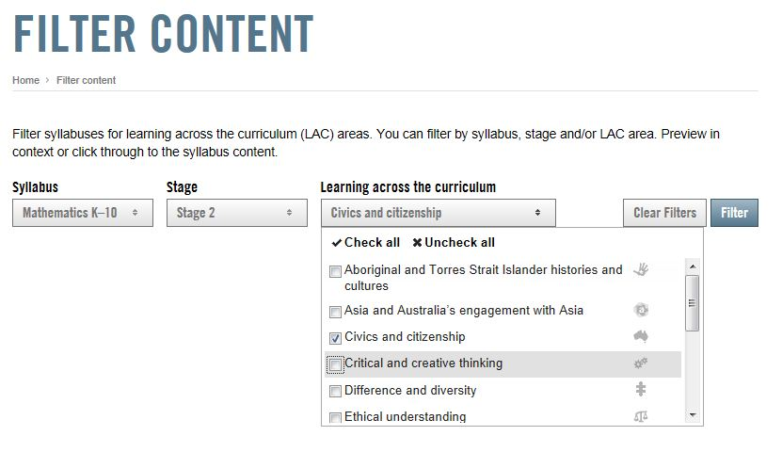
Notes:
The BOSTES website allows teachers to filter content according to a range of categories.

Slide 7
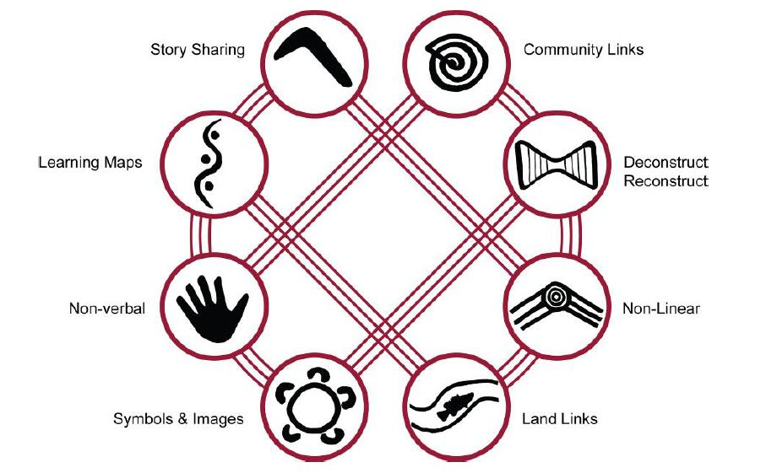
ABORIGINAL AND TORRES STRAIT ISLANDER HISTORIES AND CULTURES
Content and pedagogy
Notes:
We connect through the stories we share.
Story Sharing: Approaching learning through narrative. Personal narratives (stories) are central.
We picture our pathways of knowledge.
Learning Maps: Explicitly mapping/visualising processes. Images or visuals are used to map out processes for learners to follow.
We see, think, act, make and share without words.
Non-­‐verbal: Applying intra-­personal, hands-on and kinaesthetic skills to thinking and learning.
We keep and share knowledge with art and objects.
Symbols and Images: Using images and metaphors to understand concepts and content.
We work with lessons from land and nature.
Land Links: Place-­based learning, linking content to local land and place.
Ecological and place-based, drawn from the living landscape within a framework of profound ancestral and personal relationships with place
We put different ideas together and create new knowledge.
Non-­linear: Producing innovations and understanding by thinking laterally. Non-linear ways of learning are complementary, not oppositional
We work from wholes to parts, watching and then doing.
Deconstruct/Reconstruct: Modelling and scaffolding, working from wholes to parts. Begin with the whole structure, rather than a series of sequenced steps.
Holistic, global, scaffolded and independent learning orientations of students.
We bring new knowledge home to help our mob.
Community Links: Centering local viewpoints, applying learning for community benefit.
Connections to real-life purposes, contexts & communities, teams.

Slide 8
ASIA AND AUSTRALIA’S ENGAGEMENT WITH ASIA
Asia Education Foundation (AEF)
http://www.asiaeducation.edu.au/default.asp
Our Asian Stories
www.ourasianstories.edu.au
Studies of Asia blog
studiesofasia.blogspot.com.au
Notes:
Hans Rosling on TED talks – scatter diagrams and his work with Gapminder.

Slide 9
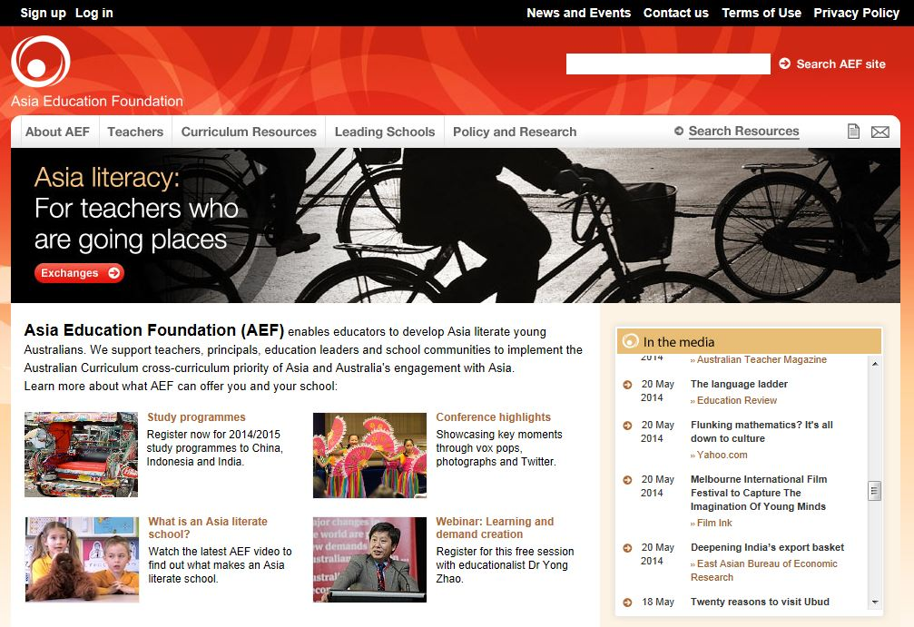
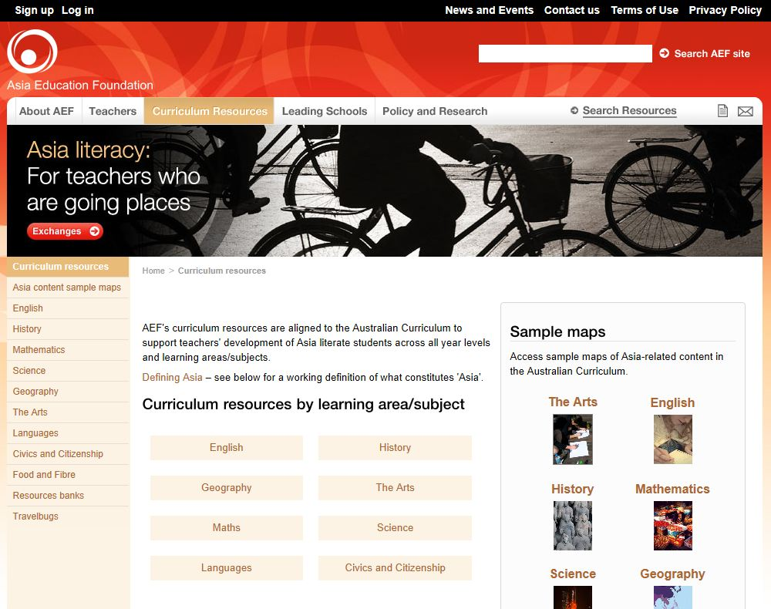

Slide 10
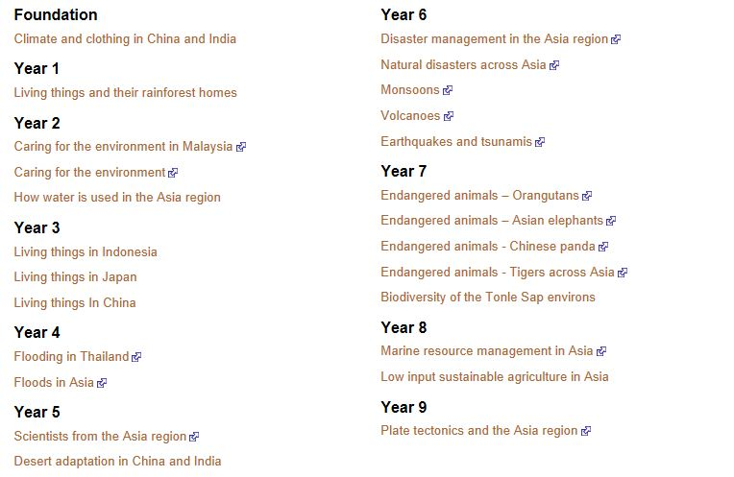
Science…

Slide 11
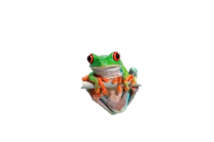
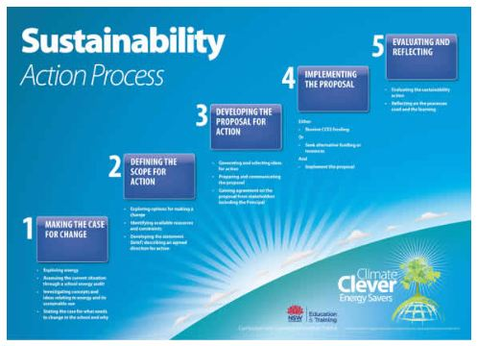
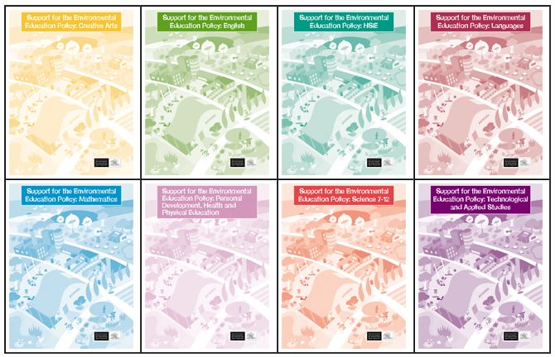
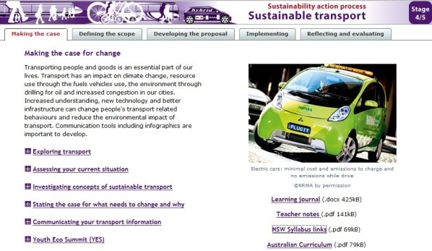
SUSTAINABILITY
Sustainability action process (SAP)
http://www.curriculumsupport.education.nsw.gov.au/env_ed/teaching/index.htm
Sustainable transport:
KLA-specific support documents (published 2000)
http://www.curriculumsupport.education.nsw.gov.au/env_ed/teaching/kla_sup/index.htm
Notes:
The Sustainability Action Process supports students to identify, investigate and take sustainability action.
At the moment, there is only one unit: Sustainable transport for Stages 4 and 5, however more resources will be added to the site over the coming months.
This unit links to science, geography and PDHPE.
Nicky Bodel’s session will take a greater look at Sustainability Action Processes.

Slide 12
LITERACY
Literacy Continuum:
http://www.literacy-continuum.det.nsw.edu.au/Matrix
Notes:
Cluster 13 (blue)

Slide 13
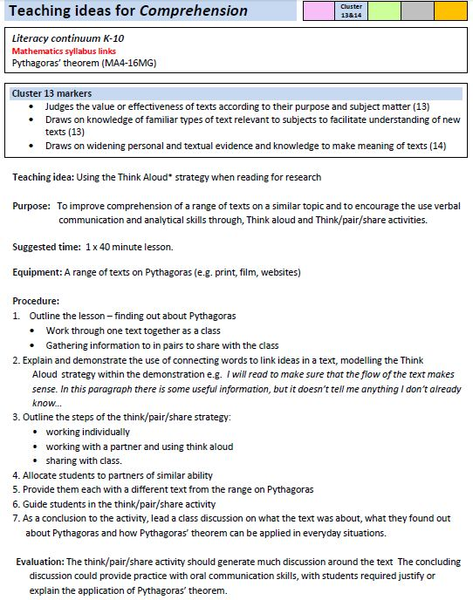
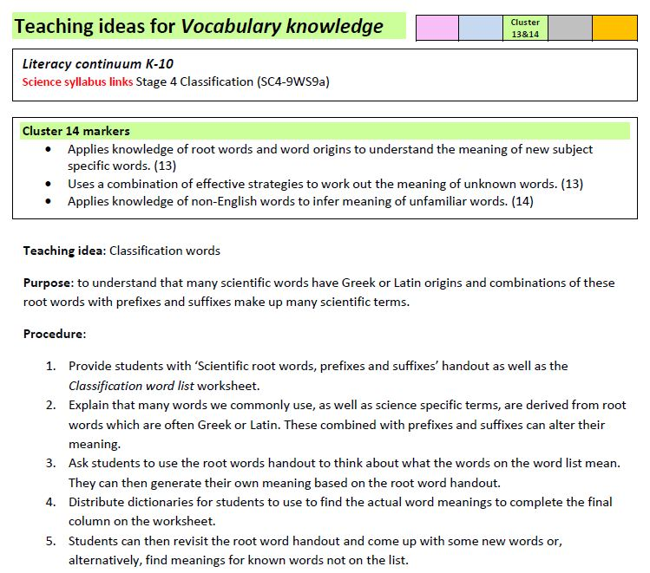

Slide 14
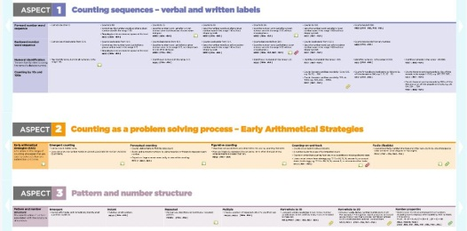
NUMERACY
Numeracy Continuum:
www.numeracycontinuum.com
Notes:
These two documents together provide a very clear snapshot of where students should be at, in terms of their numeracy skills and understanding of key mathematical concepts. They can guide teachers in planning activities for students who need additional support.

Slide 15
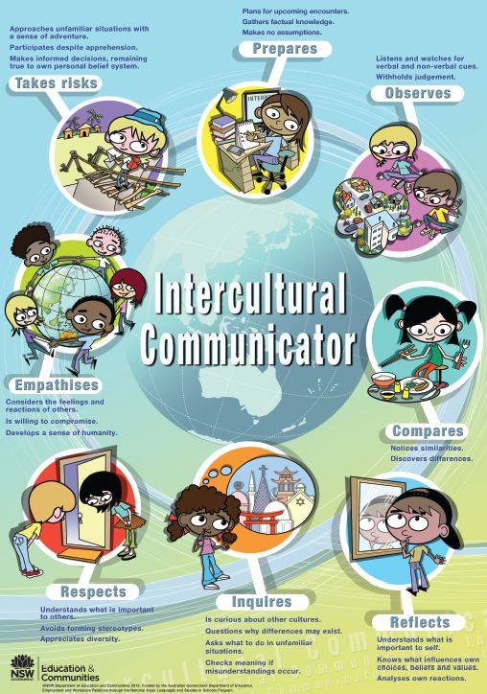
INTERCULTURAL UNDERSTANDING
Intercultural understanding:
http://interculturalcommunicationkit.
weebly.com/
Notes:
Over the next 12 months, Educational Services are planning more PL around the LATC areas.

Slide 16
Activity:
Match the
statement to the skill
Seeking solutions
Making responsible decisions
Critical and creative thinking
Personal and social capability
Understanding how society operates
Cultivating respect
Knowing what to do when faced with uncertainty
Engaging with a range of opinions
Civics and citizenship
Intercultural understanding
Ethical understanding
Difference and diversity
Challenging stereotypes
Establishing positive relationships
Developing workplace skills
Recognising commonalities and difference
Difference and diversity
Personal and social capability
Work and enterprise
Intercultural understanding
Notes:
Participants match each sentence to the correct LATC area.
Note: Participants may want to include sentences into more than one area, or may want to place a sentence into a different LATC area. This is okay as it will illustrate the overlaps between and across the LATC areas.

Slide 17
Thank you!!
Image by Lighttruth, CC BY-NC 2.0

