Slide 1
Driving Curriculum
Scope and sequencing in mathematics for your school context
Katherin Cartwright
Mathematics Advisor K-6

Slide 2
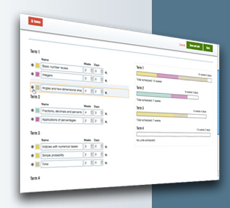
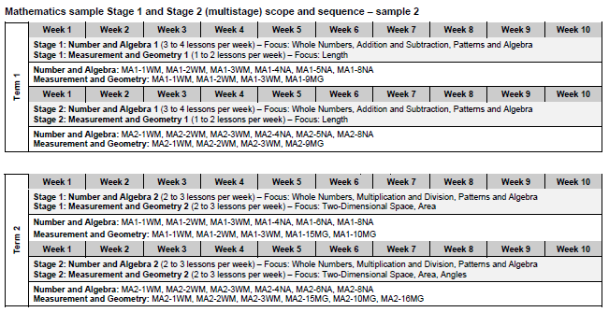
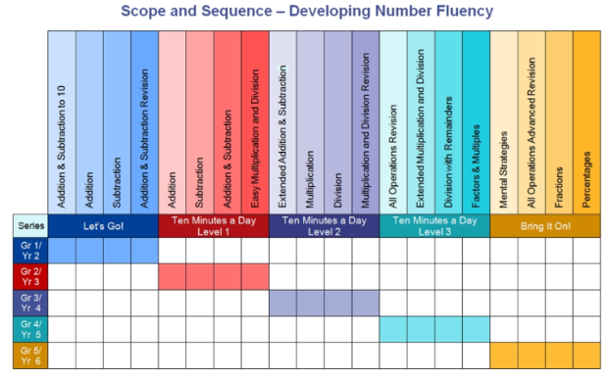
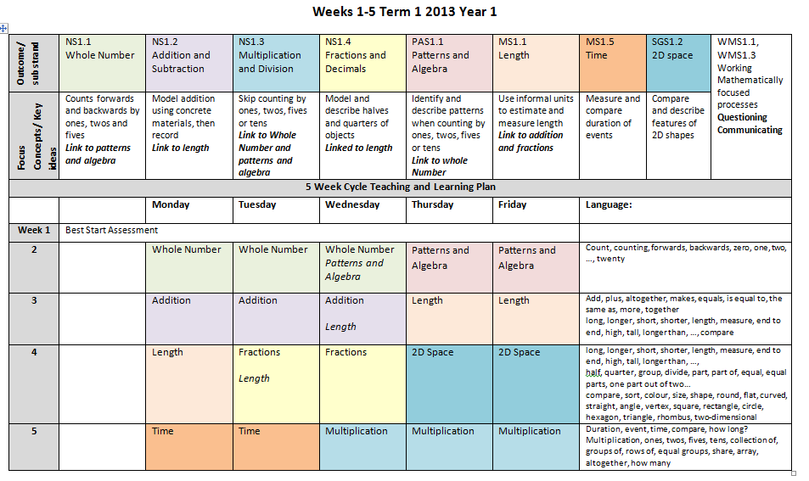
Scope and Sequence
What is it?
Why would we use one?

Slide 3
Scope and Sequence
What is it?
A scope and sequence of learning provides a view of the concepts that will be explored and the order in which they will be presented.
Scope: The breadth and depth of content to be covered in a curriculum at any one time
Sequence: The order in which content is presented to learners over time. The order in which you do it.

Slide 4
Scope and Sequence
Why would we use one?
Provides a snapshot of learning
Summarises what is to be taught and the sequence in which it will be taught
Stops the risk of ad hoc content delivery
Ensure consistency across classes in the same stage
Provides opportunities to aligning concepts that build on one another
Can show links to other KLAs
Provides teachers with a starting point/ framework from which to develop their teaching and learning programs

Slide 5
Making connections: scope and sequences
We encourage teachers to spend more time on Number as a foundation for other concepts
teachers will make decisions about the sequence, the emphasis to be given to particular areas of content, and any adjustments required based on the needs, interests and abilities of their students.
From BOSTES (Board of Studies, Training and Educational Standards) syllabus
If you are using a whole school S & S, you still need to adapt it for your students

Slide 6
Advice on developing scope and sequences
One-off lessons do not support deep knowledge
There may be overlap with substrands and other KLAS
The sample scope and sequence for each stage will assist with programming across all strands. It has been organised into five week blocks to provide opportunity for developing deep knowledge and understanding.
From NSW DEC

Slide 7
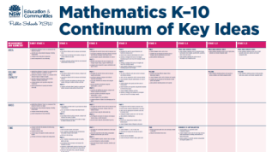
Scope and sequencing and key ideas
Teachers plan programs that are based on key ideas related to syllabus outcomes, and which build on what students know and can do.
Mathematics programming support K-6 NSW DEC
This advice is still current, our continuum of key ideas provides us with concept building blocks that guide
how we develop our teaching and learning
programs.

Slide 8
Links within scope and sequences
integrate the teaching of Patterns and Algebra with Number
link concepts in multiplication to extend understanding of area
link the teaching of fractions when teaching measurement
link fraction concepts to applications in Chance
link angles and two-dimensional space with three-dimensional space
NSW DEC

Slide 9
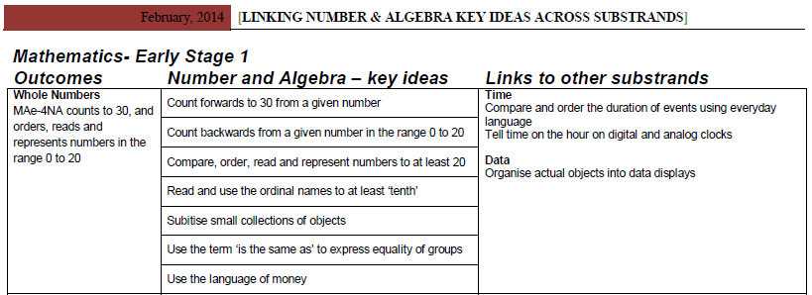
Links within scope and sequences cont.
the building of measurement concepts in sequence e.g. length before area, area before volume and capacity
linking measurement with spatial understanding e.g. area and 2D space, volume and capacity with 3D space
the teaching of fraction concepts and understanding of decimals as separate sub strands in stages 1 and 2
linking 2D with 3D space.
NSW DEC

Slide 10
What is the difference between a key idea and a concept?

Slide 11
Key ideas and concepts
Identify the key ideas and concepts that precede or follow those introduced in a particular stage of a substrand
BOSTES syllabus website
Key ideas are an overview of content and help teachers see the progression of content- What do you want students to do?
Concepts are the understandings you want students to obtain- What do I want the students to know?
Why does this learning matter?
CMIT example

Slide 12
What concept is associated with this key idea?
Stage 1 Two-Dimensional Space
Key Idea: Identify horizontal, vertical and parallel lines
Key Concept: A horizontal line is at a right angles to a vertical line (spatial reasoning)
Stage 1 Fractions & Decimals
Key Idea: Recognise, describe and represent one-half as one of two equal parts of whole objects, shapes and collections
Key Concept:
A fraction describes dividing in equal parts
A half is two equal parts of a whole or a collection
Stage 1 Addition & Subtraction
Key Idea: Use the equals sign to record equal number sentences
Key Concept: What is the conceptual understanding/s?
Notes:
The equals sign symbolises that both sides are the same
Numbers that appear on both sides must equal the same value

Slide 13
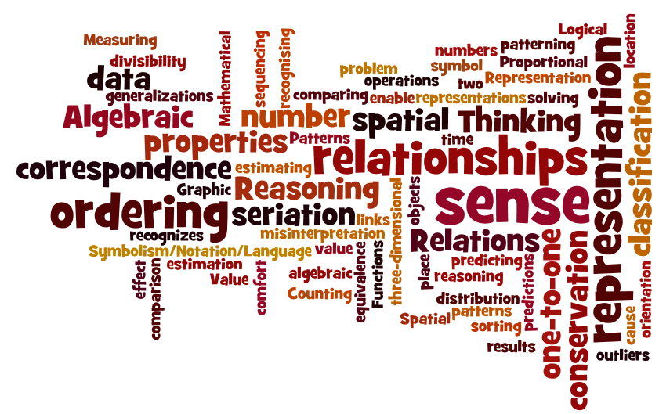
Concepts deal with…

Slide 14
The layers of scope and sequencing

Slide 15
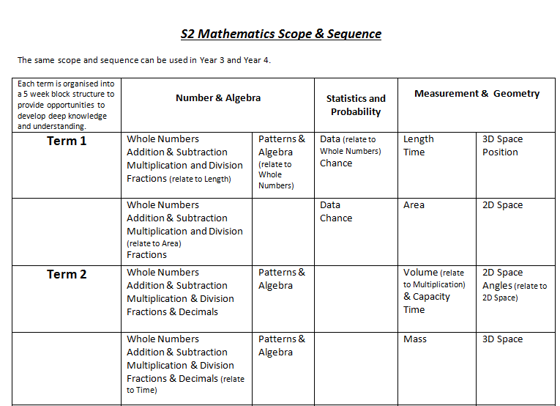
Whole School / Stage
Strand and substrand level

Slide 16
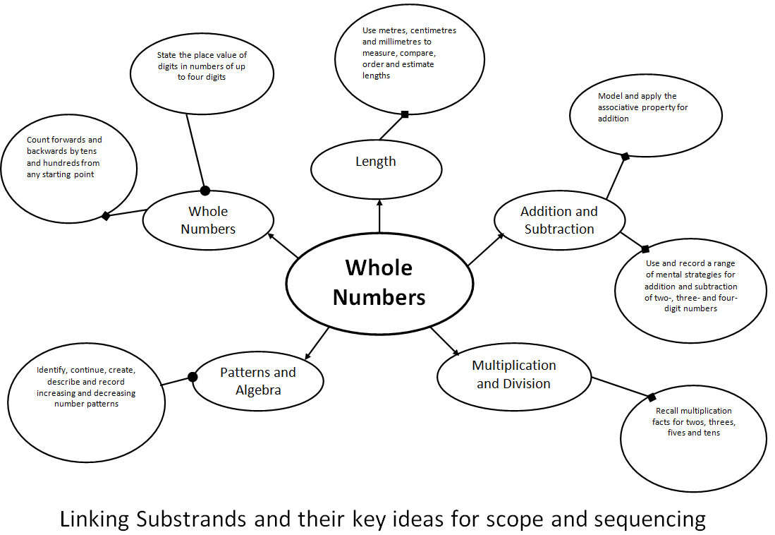

Slide 17
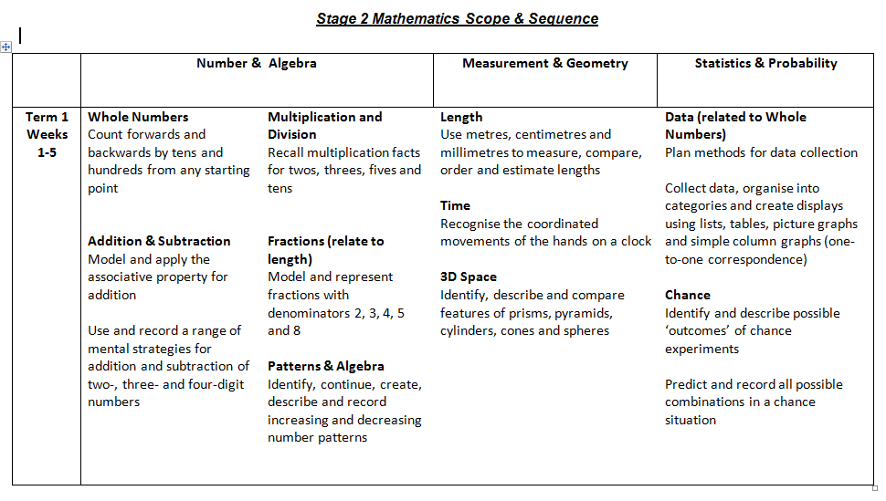
Stage/ Grade
Substrand and key ideas level

Slide 18
Stage/ Grade
Substrand and key ideas level

Slide 19
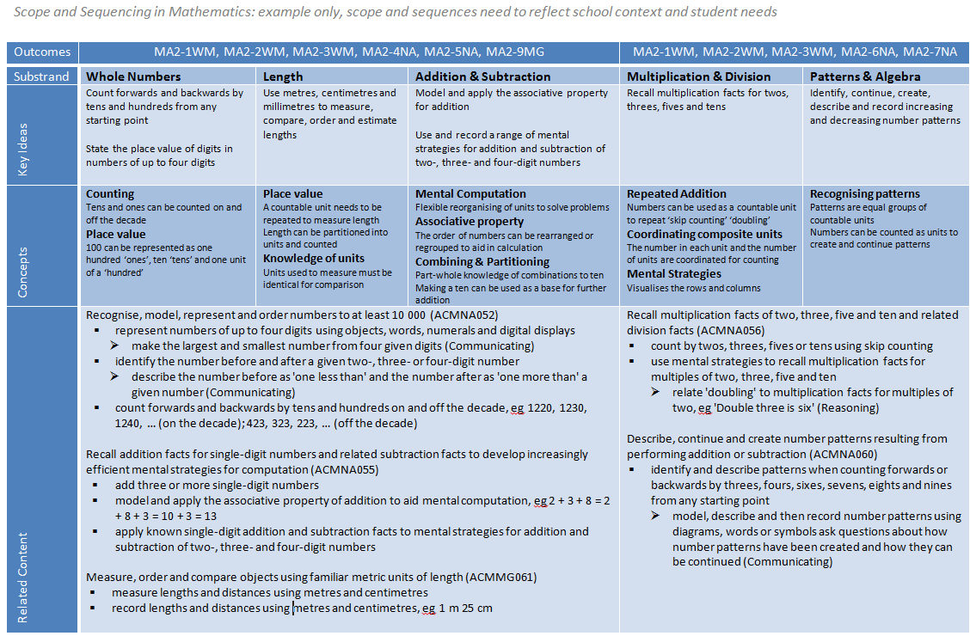
Stage/ Classroom Teacher

Slide 20
Stage/ Classroom Teacher

Slide 21
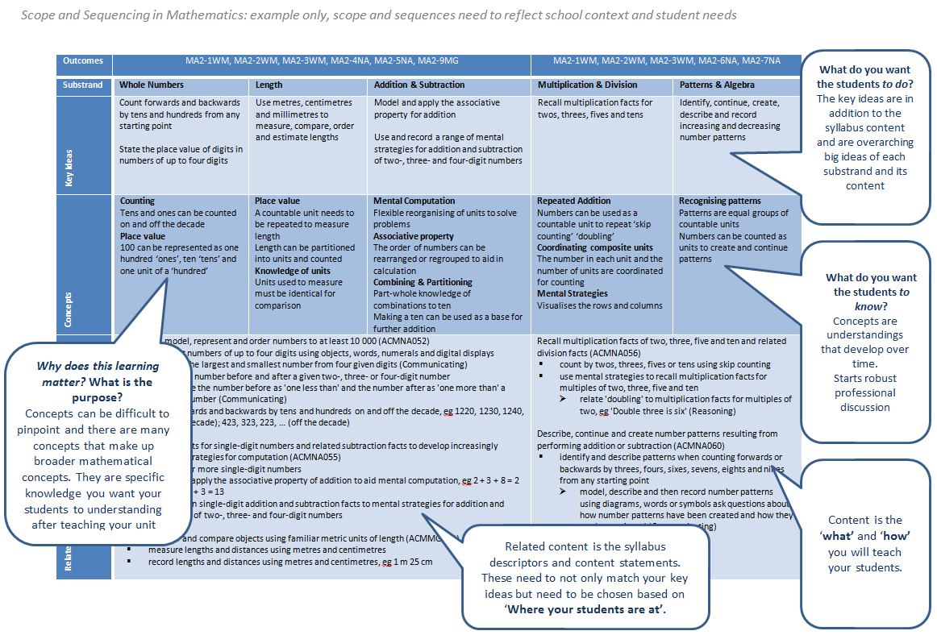
Stage/ Classroom Teacher

Slide 22
Task
Using the DEC example scope and sequence, use the Term 3 second 5 week block from an appropriate stage (or stages) to work on.
Think about your school context and your class…
Use the proforma to map out the ley ideas, concepts and content for a few of the substrands for the five week block.
You may find it easier to choose your key ideas and content and then work backwards to make sure you understand ‘Why does this learning matter?’ To complete the concepts.
These concepts link strongly to Learning Intentions you may share with your students.
Key Idea +
Syllabus
Need to understand how children learn
The development

Slide 23
Understanding big ideas
‘…develops a deep understanding of mathematics. When one understands Big Ideas, mathematics is no longer seen as a set of disconnected concepts, skills, and facts. Rather,
mathematics becomes a coherent set of ideas.’ (Randall I. Charles, 2005)
Understanding:
• is motivating
• promotes more understanding
• promotes memory
• influences beliefs
• promotes the development of autonomous learners
• enhances transfer
• reduces the amount that must be remembered.
(Lambdin 2003).
Big Ideas and Understandings as the Foundation for
Elementary and Middle School Mathematics

Slide 24
Conceptual understanding
‘Conceptual understanding in mathematics means that students understand which ideas are key (by being helped to draw inferences about those ideas) and that they grasp the heuristic value of those ideas. They are thus better able to use them strategically to solve problems – especially non-routine problems – and avoid common misunderstandings as well as inflexible knowledge and skill.
In other words, students demonstrate understanding of –
1) which mathematical ideas are key, and why they are important
2) which ideas are useful in a particular context for problem solving…’
(Grant Wiggins 2014, co-author of Understanding by Design)
http://grantwiggins.wordpress.com/2014/04/23/conceptual-understanding-in-mathematics/

Slide 25
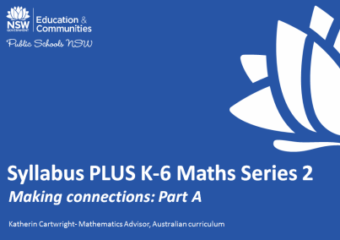
Syllabus PLUS sessions
Series 2 session 2- 4
http://www.curriculumsupport.education.nsw.gov.au/primary/mathematics/prolearn/workshops/index.htm

Slide 26
Final Comments
Concepts assist us in moving away from just teaching the content and not knowing why
The connections we can make between substrands assists students in seeing mathematics as a set of connected ideas
Scope and sequencing needs to be developed at a school level for your school context and your student needs

Slide 27
Contact Details:
Katherin Cartwright
Mathematics Advisor, K-6
Level 3, 1 Oxford St
Darlinghurst 2010
Phone: 9244 5459
Katherin.cartwright@det.nsw.edu.au
Thanks

